Slide 1
Multiple Pathways to High School Equivalency (MPHSE)
Presented by:
Penny Wacaster, NCCCS HSE Representative for MPHSE
This presentation will be recorded and shared for on-demand viewing.

Slide 2
MPHSE Training Objectives
Introduce Multiple Pathways to High School Equivalency (MPHSE) to all NC Community Colleges
Provide training guidance on determining if a student is an MPHSE candidate
Explain steps to document, get approval and submit a student as an MPHSE candidate
Explain final approval process to gain an HSE diploma for the student

Slide 3
MPHSE Advisory Board :
Brad Bostonian – Central Piedmont CC
Amanda Bradshaw - Sampson CC
Rachel Clark – Haywood CC
Renita Dawson – Wayne CC
Claudia Farnandez – formerly NCCCS System Office
Lisa Johnson – Alamance CC
Diane Matlock – Carteret CC
Jennifer McLean – NCCC System Office
Jill Storey – Davidson-Davie CC
Jenifer Bean – NCCCS System Office
Penny Wacaster – McDowell Technical CC
Debbie Woodard – Wilkes CC
Thank you!

Slide 4
Background:
MPHSE diploma program is a standardized performance assessment for the completion of a HSE diploma.
A formalized system provides students with a clear and flexible conduit by combining multiple sources of competencies.
The student is required to demonstrate high school-level competencies in the five selected content areas.
After completion of all requirements, an HSE diploma will be awarded through the North Carolina State Board of Community Colleges.
Notes:
The Multiple Pathways to High School Equivalency (MPHSE) diploma program is a standardized performance assessment program for the completion of a high school equivalency diploma.
The MPHSE establishes a formalized system to provide students with a clear and flexible conduit toward earning a high school equivalency credential by combining multiple sources of competencies.
The student is required to demonstrate high school-level competencies in the five selected content areas.
Once the student has satisfactorily completed all requirements, a high school equivalency diploma will be awarded through the North Carolina State Board of Community Colleges.

Slide 5
Multiple Pathways Content Areas:
English Language Arts/Literacy (Reading & Writing)
Mathematics
Science
Social Studies
Technology

Slide 6
Elements to Determine Credit :
High School Courses
Adult High School Courses
High School Equivalency Assessments
BSP Transition Courses
NorthStar Certifications
Note: Specifics on acceptable credits are outlined in MPHSE Guidelines: Appendix A MPHSE Content and Credit Verification Structure
Notes:
The following may be used in combination to demonstrate completion of content areas:

Slide 7
MPHSE Process:
Evaluate all applicable transcripts for High School and/or Adult high school, HSE test results, BSP course credits, and NorthStar credentials.
Transfer all qualifying credits to the MPHSE Worksheet
High school and adult high school grades of C or better
BSP course results/grades
High school equivalency results (must be a passing score per vendor guidelines)
NorthStar credentials, 85% or higher
Notes:
- Gather all information and evaluate your students credits, assessments, etc
- All supporting documentation must be kept in the student's permanent file

Slide 8
Transfer all valid credits for all content areas to the Documentation and Summary Authorization (DSA) form.
DSA form must be completed by the Transcript Evaluator.
DSA form is verified and approved by the CCR Chief Administrator
The approved DSA form is emailed to the NCCCS HSE Representative.
All documentation used to determine acceptable credits, MPHSE Worksheet and MPHSE DSA must be kept in student's permanent file.
Notes:
The TE is different in every program but could be a Coordinator, Student Affairs personnel, CCR Administrator, etc.
CCR CA = Director, Dean ,etc. the person in charge of the CCR program

Slide 9
After evaluation by the HSE representative, the signed DSA form is emailed to the CCR CA or designate to be uploaded into DiplomaSender.
CCR CA will create an account in DiplomaSender and upload the approved DSA as supporting document.
The HSE representative will approve the diploma within 2 weeks.

Slide 10
English Language Arts Literacy
Pathway 1: High School Courses
The student must successfully complete 4 credits in a combination of high school and adult high school courses with a C or better grade: English I, English II, English III, and English IV. Transition English BSP-4002 Tier I can be substituted for English IV.
 | Course Name | Grade | Date
English I | English 1 | B | 12/17/2010
English II | English 2 | D | 6/08/2011
English III
English IV
Pathway 2: Adult High School Courses
The student must successfully complete 4 credits in a combination of high school and adult high school courses with a C or better grade: English I, English II, English III, and English IV. Transition English BSP-4002 Tier I can be substituted for English IV.
 | Course Name | Grade | Date
English I
English II
English III | English 3 | D | 10/11/2015
English IV
Pathway 3: High School Equivalency Assessments
The student must complete the applicable section(s) of a high school equivalency test: GED 2014, HiSET, or TASC with the required score(s).
Test Name | GED 2014 | HiSet | TASC
Score(s) | 148
Test Date: | 2/20/2018

Slide 11
After the MPHSE Worksheet has been completed. Transfer only the credits that will be used to attain a MPHSE diploma to the DSA form.
The Transcript Evaluator will complete the top portion of the form (see example below). Please do not completely fill in birthdate or social security number.
Multiple Pathways to High School Equivalency - Documentation Summary and Authorization
College Your Community College
Full Name of Student Annie Student Colleague ID 999999 Date of Birth 3/5/XXXX SSN XXX-XX- 1234
Mailing Address 123 Main Street, Anywhere NC 55555
Cell Number 111-222-3344 Home Number N/A Email abstudent@yahoo.com

Slide 12
Content Area | High School Course |  | Adult High School Course |  | HSE Assessment |  | BSP Transition Course |  | Northstar Certification |  | Final Date Awarded
 | Course Name | Grade | Course Name | Grade | Test Name | Score | Course Name | Grade | Assessment Name | Score
English Language Arts/Literacy |  |  |  |  | GED | 148 |  |  |  |  | 2/20/2018
Mathematics |  |  |  |  | HiSet | 8 |  |  |  |  | 5/4/2020
Science | Physical Science Biology | B B | Earth & Environmental | C |  |  |  |  |  |  | 12/20/2016 6/7/2017 10/15/2019
Social Studies |  |  |  |  | HiSet | 12 |  |  |  |  | 6/10/2021
Technology |  |  |  |  |  |  |  |  | Basic Comp. Skills Internet Basics Using Email Microsoft Word Social Media Information Literacy | 90 91 88 87 95 86 | 4/5/2022 4/5/2022 4/8/2022 4/11/2022 4/15/2022 4/25/2022

Slide 13
I certify that the above-named person has satisfactorily completed all graduation requirements to earn a high school equivalency
diploma under the guidelines set forth by the Multiple Pathways to the High School Equivalency Diploma program as authorized by
the North Carolina Community Colleges State Board of Community Colleges.
Transcript Evaluator (Print) Sandra Evaluator Sign Sandra Evaluator Date 5/5/2022
CCR Chief Administrator (Print) Bob Director Sign Bob Director Date 5/5/2022
HSE Office Approval (Print) Penny Wacaster Sign Penny Wacaster Date 5/8/2022 _

Slide 14
Considerations for MPHSE Candidacy
Has the student been enrolled in classes for a long time?
Has the student struggled to pass HSE exams in a certain subject area?
Does the student have any documented high school credits?
Has the student demonstrated more success in the classroom setting than in taking a comprehensive exam?

Slide 15
DiplomaSender Demo
Demonstration by DiplomaSender Representatives

Slide 16
DiplomaSender Submission Steps
Log in to DiplomaSender
Click on Admin (top right corner)
Under Custom Programs, click on “North Carolina Multiple Pathways to High School Equivalency”
Click ADD (top left corner) to show all required entries.
Enter the Student Data (Note: Please confirm the student’s email address is entered correctly. DiplomaSender will send an email to the address listed after MPHSE approval)
Upload the approved & signed “MPHSE Documentation Summary and Authorization” for the student.
Check boxes for “Summary Authorization” and “Documentation of Credit”
Click ADD

Slide 17
Gather all credit information
Transfer credits to MPHSE Worksheet
Evaluate credits and transfer credits that meet MPHSE guidelines to DSA
CCR CA approves credits on DSA
Student's information uploaded in DiplomaSender
Student Graduates!!!
HSE representative approves DSA

Slide 18
Example email to Student from DiplomaSender

Slide 19
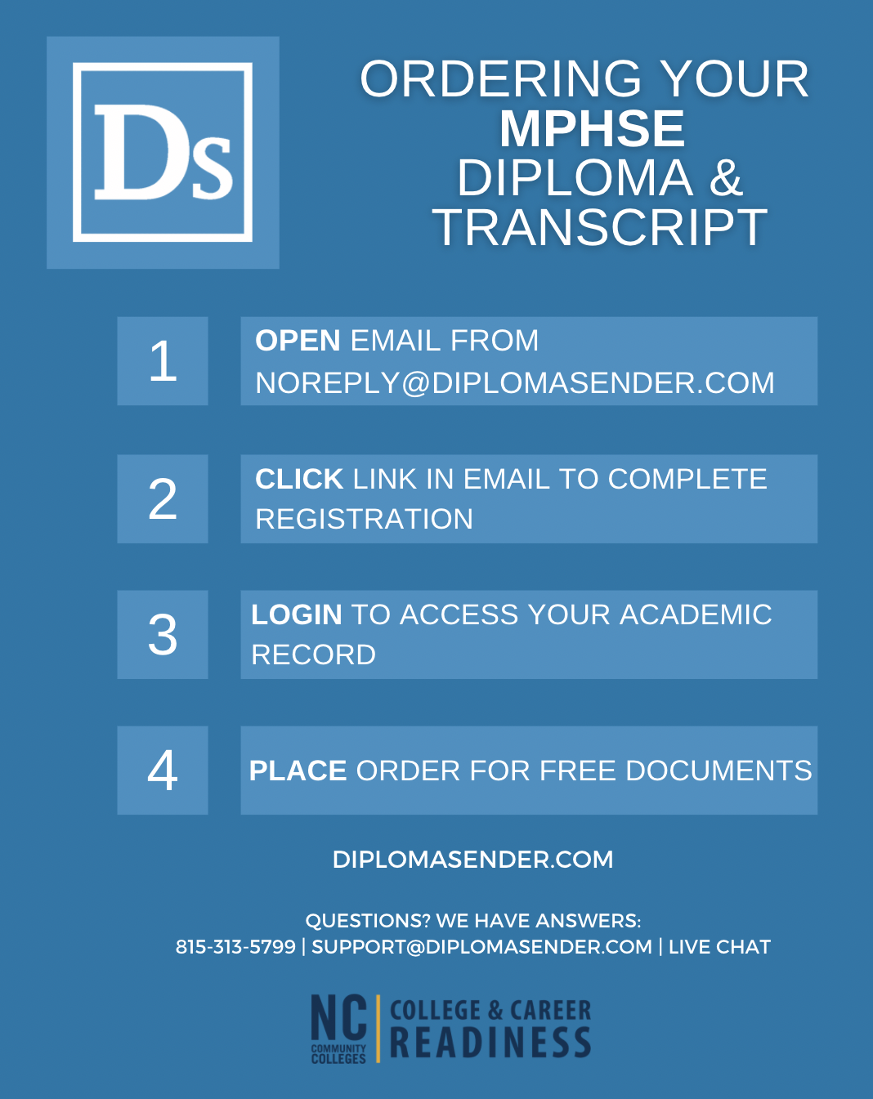

Slide 20
Sample MPHSE Transcript

Slide 21
Sample MPHSE Diploma

Slide 22
Entering MPHSE Graduates into Your Data Management System
Colleague: HSEMP Program (will send reference document in follow-up)
ADVANSYS: DiplomaSender direct feed – no entry required! (starts next week)

Slide 23
Wrap Up:
For more information refer to
MPHSE Training Document
MPHSE FAQs document
Immediate questions can be directed to Penny Wacaster at pmwacaster83@go.mcdowelltech.edu

